Slide 1
Naive Bayes Classification

Slide 2
What is Naive Bayes algorithm?
The Naive Bayes Classifier technique is based on the so-called Bayesian theorem and is particularly suited when the dimensionality of the inputs is high. Despite its simplicity, Naive Bayes can often outperform more sophisticated classification methods.

Slide 3
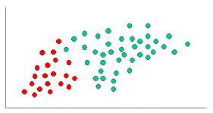
the objects can be classified as either GREEN or RED. Our task is to classify new cases as they arrive, i.e., decide to which class label they belong, based on the currently exiting objects.

Slide 4
Since there are twice as many GREEN objects as RED, it is reasonable to believe that a new case (which hasn't been observed yet) is twice as likely to have membership GREEN rather than RED.
In the Bayesian analysis, this belief is known as the prior probability. Prior probabilities are based on previous experience, in this case the percentage of GREEN and RED objects, and often used to predict outcomes before they actually happen.

Slide 5


We can write
Since there is a total of 60 objects, 40 of which are GREEN and 20 RED, our prior probabilities for class membership are:

Slide 6
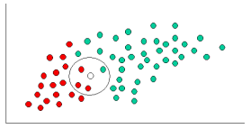
Having formulated our prior probability, we are now ready to classify a new object (WHITE circle). Since the objects are well clustered, it is reasonable to assume that the more GREEN (or RED) objects in the vicinity of X, the more likely that the new cases belong to that particular color. To measure this likelihood, we draw a circle around X which encompasses a number (to be chosen a priori) of points irrespective of their class labels.

Slide 7



Then we calculate the number of points in the circle belonging to each class label. From this we calculate the likelihood:

Slide 8
Although the prior probabilities indicate that X may belong to GREEN (given that there are twice as many GREEN compared to RED) the likelihood indicates otherwise; that the class membership of X is RED (given that there are more RED objects in the vicinity of X than GREEN). In the Bayesian analysis, the final classification is produced by combining both sources of information, i.e., the prior and the likelihood, to form a posterior probability using the so-called Bayes' rule (named after Rev. Thomas Bayes 1702-1761).

Slide 9
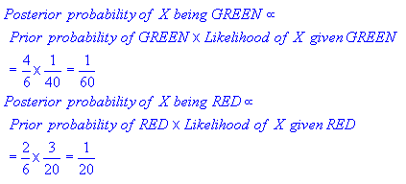
Finally, we classify X as RED since its class membership achieves the largest posterior probability.

Slide 10
4 Applications of Naive Bayes Algorithms
Real time Prediction: Naive Bayes is an eager learning classifier and it is sure fast. Thus, it could be used for making predictions in real time.
Multi class Prediction: This algorithm is also well known for multi class prediction feature. Here we can predict the probability of multiple classes of target variable.

Slide 11
Text classification/ Spam Filtering/ Sentiment Analysis: Naive Bayes classifiers mostly used in text classification (due to better result in multi class problems and independence rule) have higher success rate as compared to other algorithms. As a result, it is widely used in Spam filtering (identify spam e-mail) and Sentiment Analysis (in social media analysis, to identify positive and negative customer sentiments)

Slide 12
Recommendation System: Naive Bayes Classifier and Collaborative Filtering together builds a Recommendation System that uses machine learning and data mining techniques to filter unseen information and predict whether a user would like a given resource or not

Slide 13
How to build a basic model using Naive Bayes in Python?
Again, scikit learn (python library) will help here to build a Naive Bayes model in Python. There are three types of Naive Bayes model under scikit learn library:
Gaussian: It is used in classification and it assumes that features follow a normal distribution.

Slide 14
Multinomial: It is used for discrete counts. For example, let’s say, we have a text classification problem. Here we can consider bernoulli trials which is one step further and instead of “word occurring in the document”, we have “count how often word occurs in the document”, you can think of it as “number of times outcome number x_i is observed over the n trials”.

Slide 15
Bernoulli: The binomial model is useful if your feature vectors are binary (i.e. zeros and ones). One application would be text classification with ‘bag of words’ model where the 1s & 0s are “word occurs in the document” and “word does not occur in the document” respectively.

Slide 16
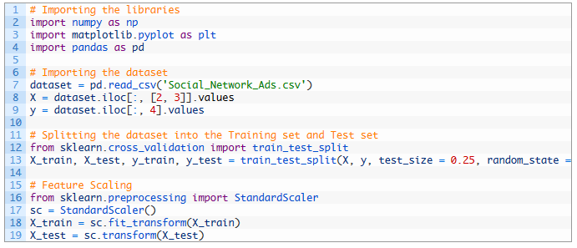
Data Processing

Slide 17
We read “Social_Network_Ads.csv” file and stored in dataset.
Extracted age and salary information from dataset and stored in X
Extracted purchase information from dataset and stored in Y.
Split dataset in training and test set so that machine can be trained using X_train and Y_train
Used feature scaling for X_train.

Slide 18

Naive Bayes Classification:
Imported GaussianNB from sklearn.naive_bayes
Created a classifier and fitted training set to it.

Slide 19
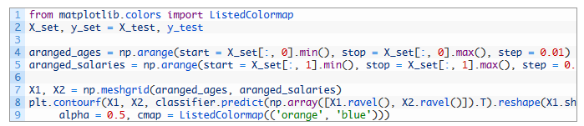
Plotting the Graph:

Slide 20
aranged_ages variable will have scaled ages of users starting from minimum age to maximum age incremented by 0.01.
aranged_salaries variable will have scaled salaries of users starting from minimum salary to maximum salary incremented by 0.01.
np.meshgrid() takes aranged_ages and aranged_salaries to form X1 and X2.
X1 and X2 are used for creating a graph which classifies all data points using naive bayes classification. It is done using plt.contourf(), method.

Slide 21
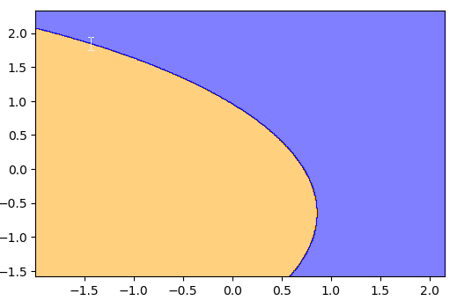

Slide 22
Naive bayes classification draws a curve and creates orange and blue sections
orange section is of users who will not buy the car and blue section is for users who will buy the car

Slide 23
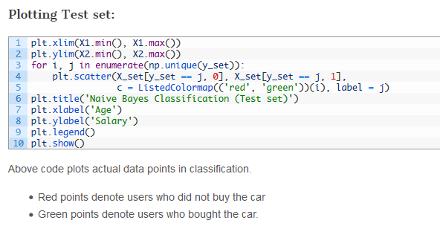

Slide 24
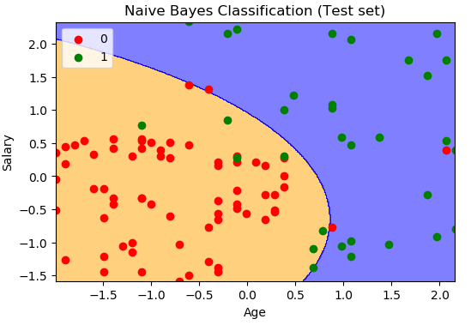

Slide 25
Note that we have plotted 100 observations from our test set and out of them
7 green points are observed on orange area
3 red points are observed in blue area
This means, out of 100 observation points, Naive Bayes classification predicted 90 results correctly and only 10 are incorrect.

